Slide 1
Risk Factors for Injuries in Road Collisions
Reuben Walker, Keegan MacDonald, Sanita Richards & Corey Thorne

Slide 2
Introduction
The Canadian National Collision Database contains information on all police-reported vehicle collisions in 2019.
We will create a model to predict the severity of these collisions based on other available information.
The 3 severity levels:
No Injury
Injury
Fatality

Slide 3
Data Inspection
Each observation corresponds to one person who was involved in a vehicle collision (including passengers or people not in the vehicle)
Our dataset contains mostly categorical variables including:
Month & weekday of collisions,
Sex of person involved in collision,
Road type (intersection, passing lane, bridge, etc.),
Weather conditions,
Numeric variables: number of cars involved, hour of collision, year of car manufacture, age of person involved in collision
Most variables have extra categories for unknown/missing data.
The dataset contains 272301 observations.

Slide 4
Data Cleaning
We removed all observations containing unknown/missing values.
Remove six columns not useful for machine learning:
The year 2019 (redundant & same for all entries)
Three columns containing unique identifiers for collisions,
A duplicate of the target variable (the severity of the collisions), and
A column for protective clothing and safety devices which contains mostly missing values.
17 columns and 167803 observations remain in the dataset.

Slide 5
Exploratory Data Analysis
After cleaning the data, we had:
76530 “No Injury” entries
90299 “Injury” entries
974 “Fatality” entries
The non-injury and injury collisions appear in similar numbers, but there are significantly less fatalities
The number of non-injury, injury and fatal collisions can be visualized across the other variables in the dataset:

Slide 6
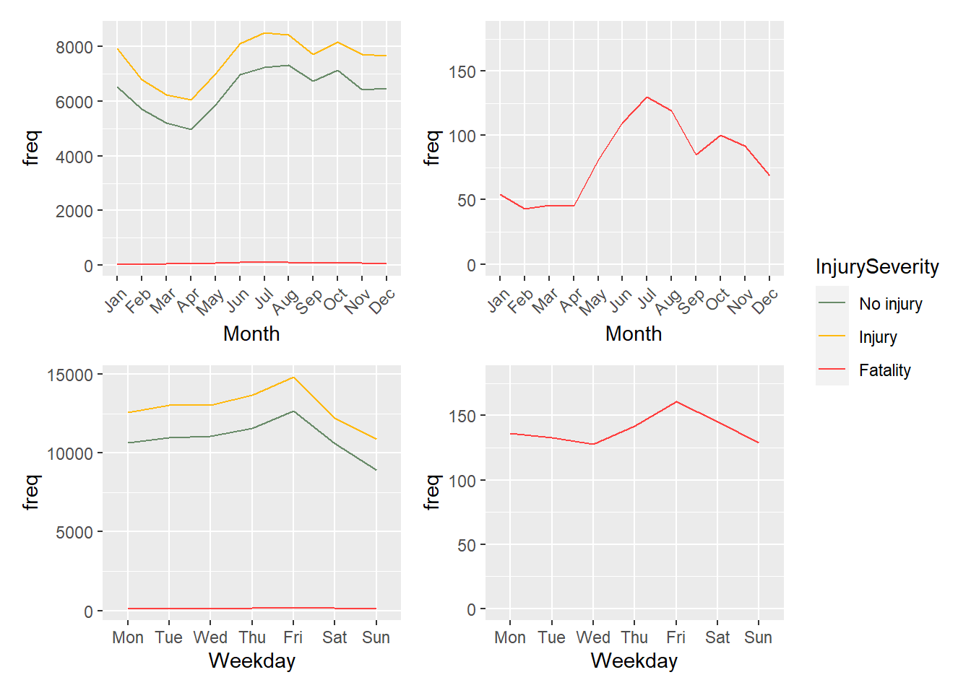
Visualization by Month & Weekday,
More collisions occurred in the summer months compared to the winter months
Throughout the week, collisions rose Mon – Fri but dropped over the weekend
As we can see, the amount of fatalities is a tiny fraction of the overall collisions, so it requires separate graphs
Fatalities follow similar patterns to other collisions in this context

Slide 7
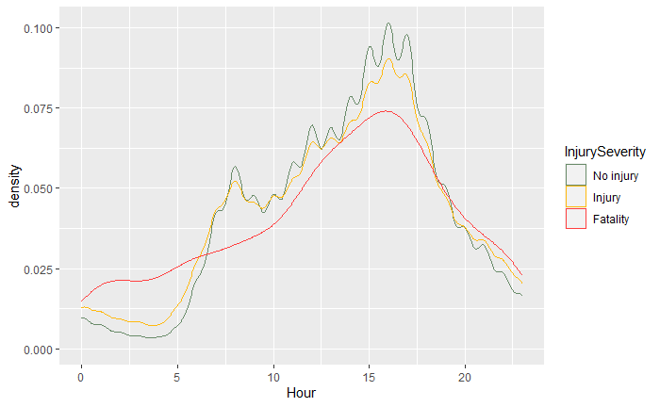
… by Time of Day,
The instances of all types of collisions appear most during the hours of 3:00 PM to 6:00 PM.
This is likely a result of many people being on the road after leaving work.
There is also a notable spike between 6:00 AM and 9:00 AM, at the time people first leave in
the morning.
During the night, all types of collisions are low but fatalities occur at a relatively high rate… time might be a good indicator

Slide 8
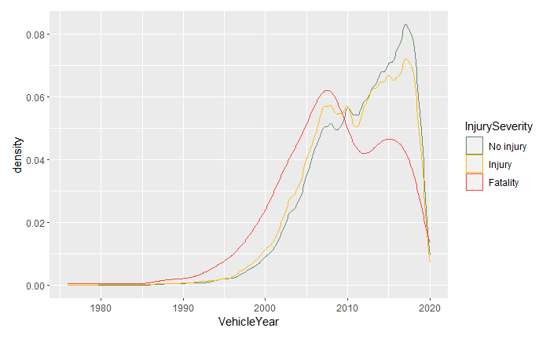
… by Vehicle Year,
The manufacturing date of vehicles involved in collisions is tracked by this dataset.
The peak in red shows a relatively high fatality rate in cars manufactured before 2010.
The drop-offs before 2005 and after 2020 are the result of few cars being on the road made outside this timespan.
In the original data, there were 17 cars manufactured before 1920!

Slide 9
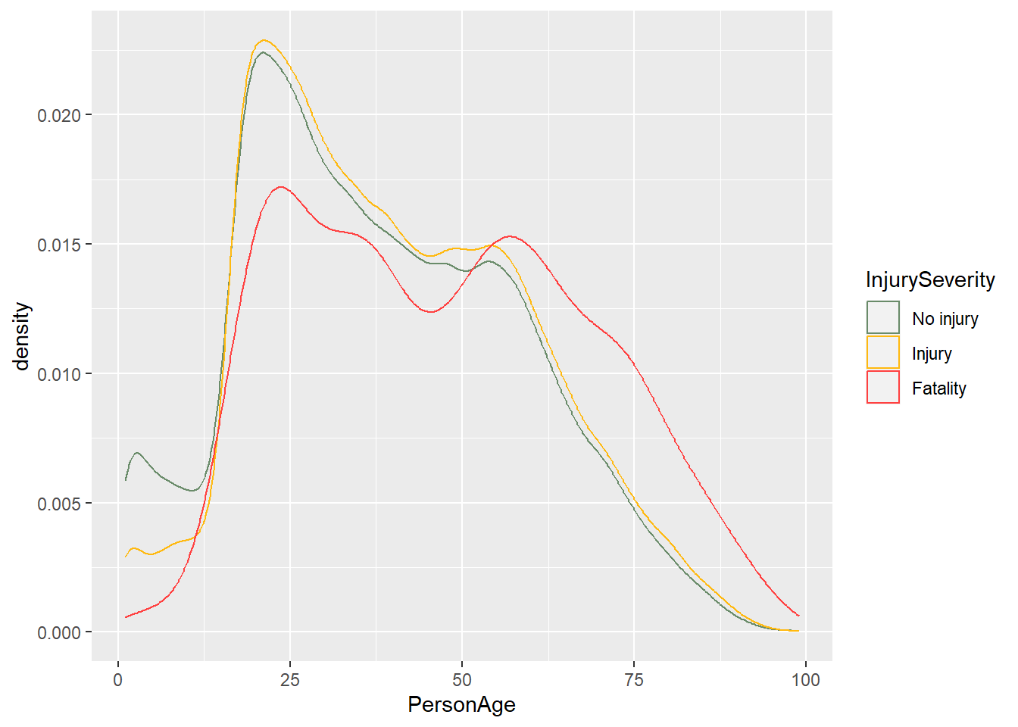
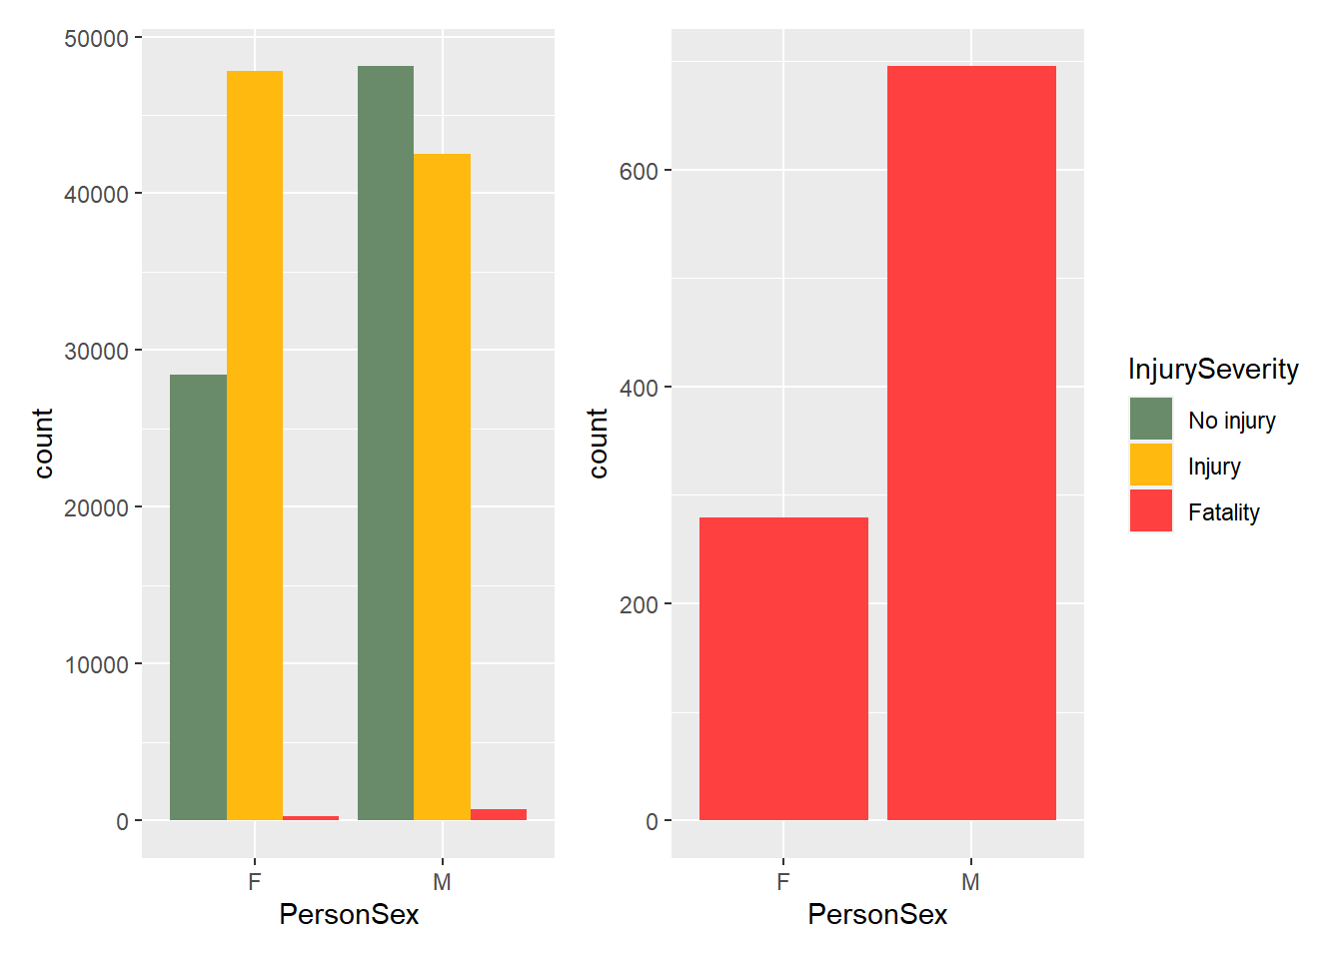
… by Sex & Age
Higher rates of fatalities for males, but higher rates of injuries for females

Slide 10
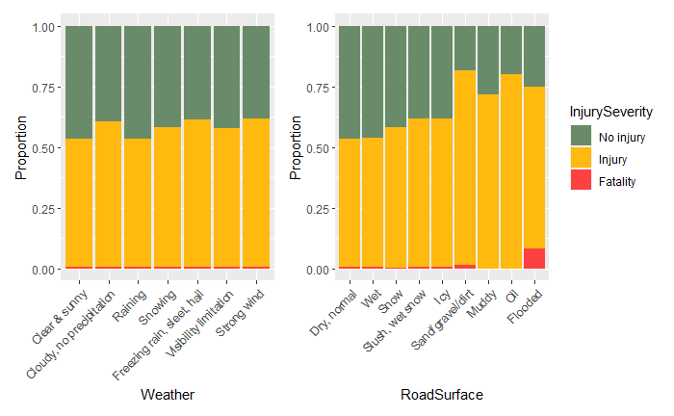
… by Weather and Road Conditions
Many types of weather and road surface conditions are tracked for collisions in this dataset.
They show minimal differences across all weather conditions, relatively high rates of injury on dirt/gravel roads, and relatively high fatality rates on flooded roads.
The fatalities are almost invisible because of their small numbers except on flooded and dirt roads.

Slide 11
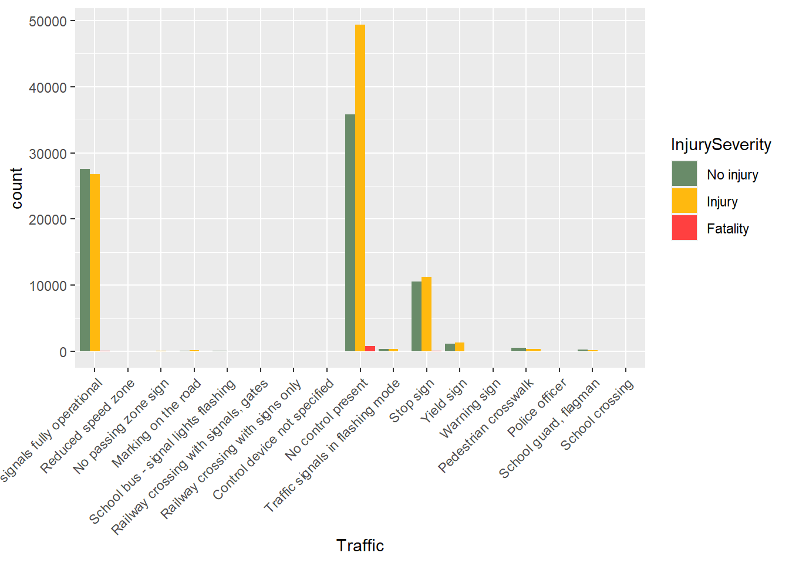
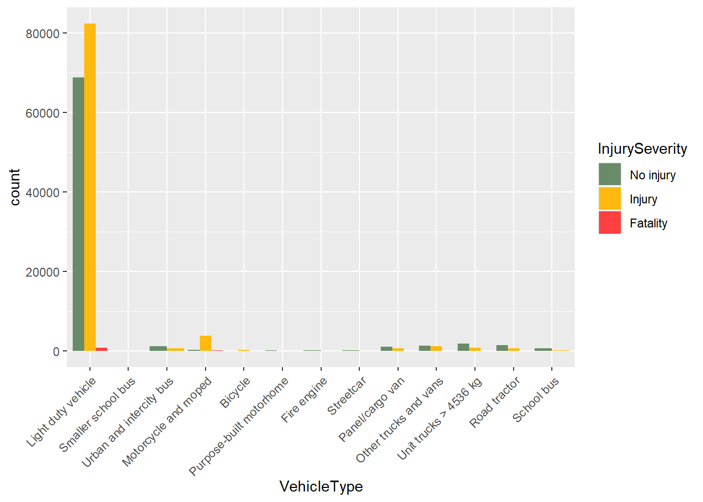
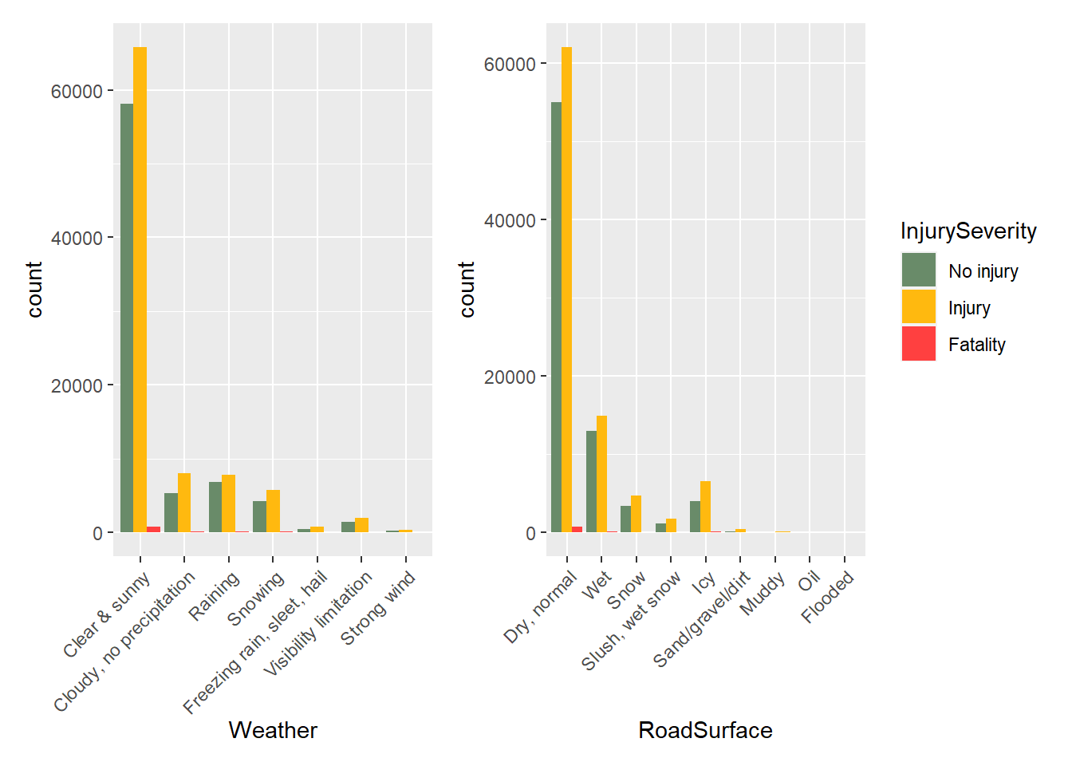
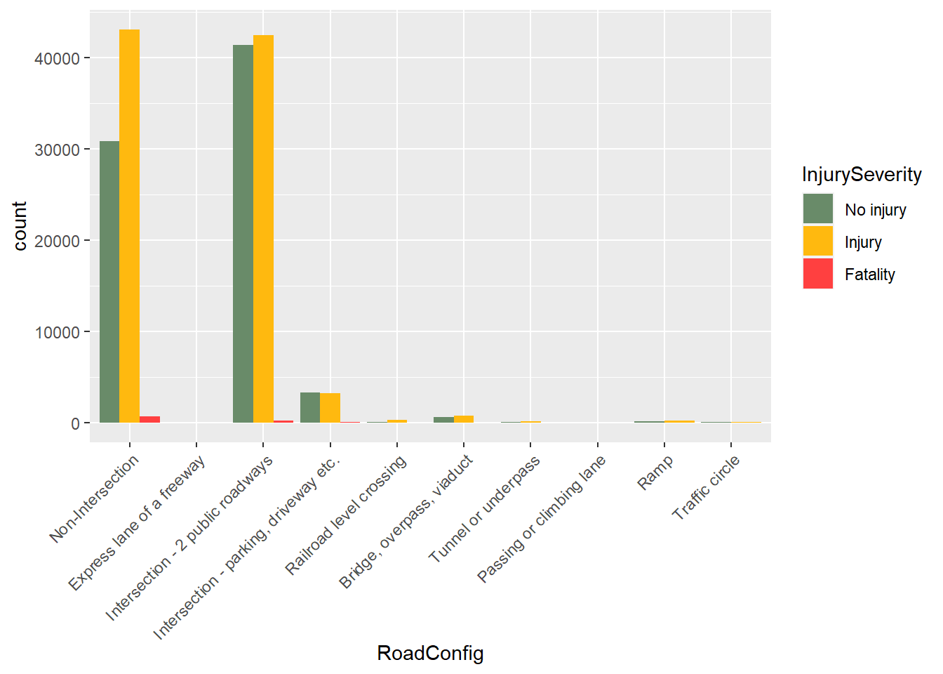
Note: some categories dominated
Many variables were dominated by one category, because they were overwhelmingly common
Vehicle type, weather, road surface, traffic, and road configuration are some examples

Slide 12
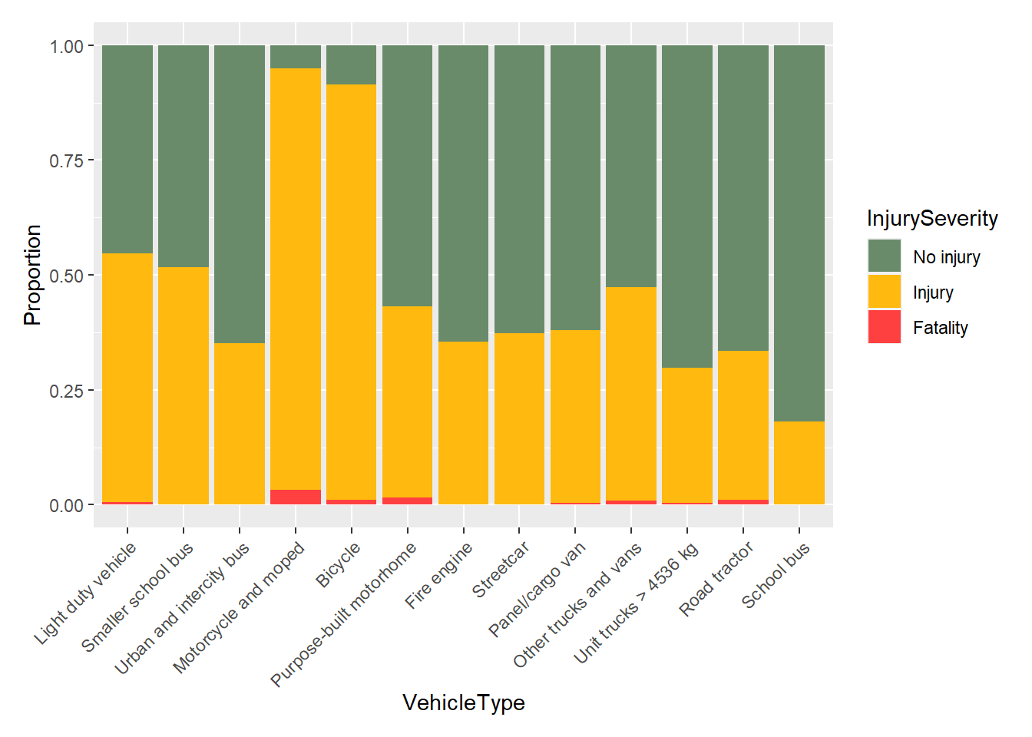
Representing data proportionally
Representing these heavily-dominated variables in a proportional manner helps us better visualize the data

Slide 13
Training Parameters
900 observations of each type (non-injury, injury, and fatal) were sampled randomly from the dataset.
75% of this data was used as training data and the remaining 25% became the validation set.
Training was set to use 20-fold cross-validation, with the accuracy performance metric.

Slide 14
Modelling
We used four models:
Classification & Regression Trees (C&RT)
K-nearest Neighbors (KNN)
Support Vector Machines (SVM)
Generalized Linear Models (GLM)
Our consistently best performing model has been GLM.
None of these models achieved > 70% accuracy.

Slide 15
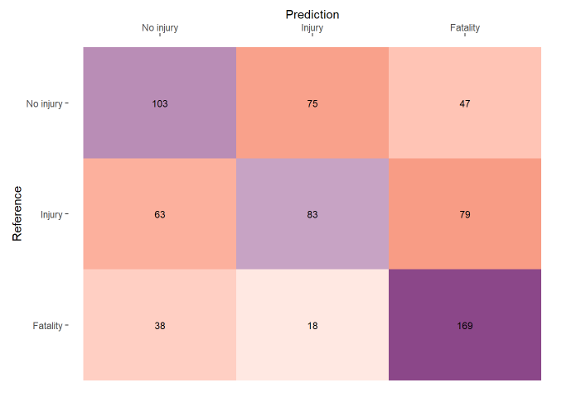
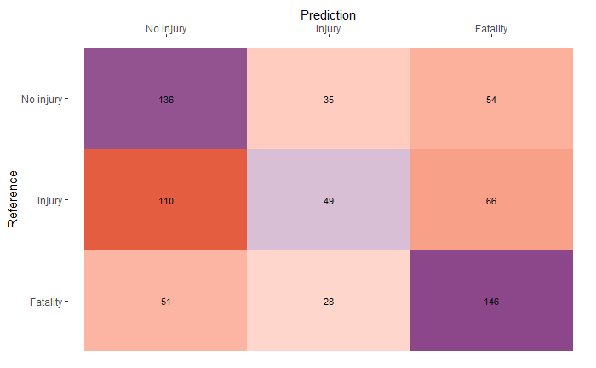
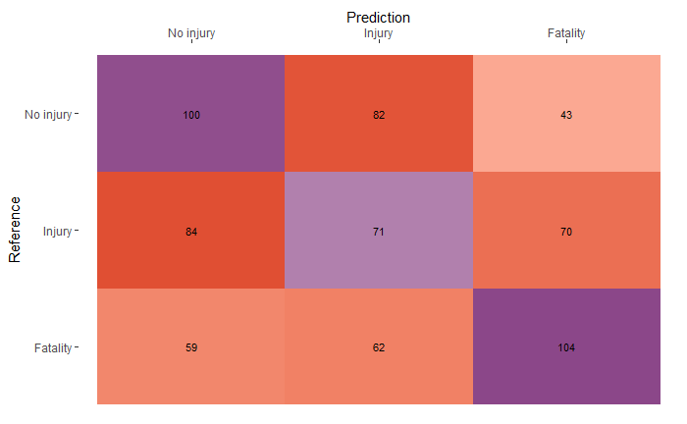
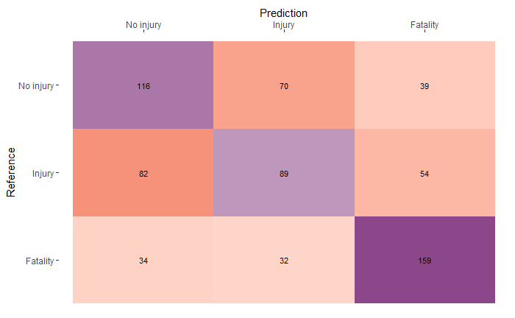
Sample Confusion Matrices
C&RT
KNN
SVM
GLM

Slide 16
Conclusions
The best performing model was Generalized Linear Modelling.
Our model accuracy could be improved by:
Reducing the number of predictor variables
Grouping predictor variables into fewer categories
Grouping the target variable into simpler categories (ex. non-fatal and fatal).

